Slide 1

Test Driven Development
with Sam Gibson and Mary-Anne Cosgrove

Slide 2

Hi, I'm Sam!
I play videogames
I write software
I drink beer
(… sometimes all at the same time)

Slide 3

I'm MAC ☺
I'm a Java and Ruby developer
I've been developing for 20+ years
I've been with ThoughtWorks for 18 months
I LOVE test driven design because I love seeing red lights turn green

Slide 4
Learning Objectives
Why test?
Why test first?
What to test?
Testing techniques?
Convinced?
Notes:
(SAM DRIVES FROM HERE UNTIL THE ‘BUT IT’S HARD’ SLIDE)
As usual we will both contribute to the discussion and ad hoc add stuff in.
Quickly sum up our learning objective and then move on.

Slide 5
So…
Why do we test?
Notes:
Question is broad, intentionally: Why do we do any kind of testing? Automated or otherwise?
Engagement questions:
Who here has written a test before?
Why did you write tests?
Why *do* we test?
* Give us some empirical degree of confidence that our code is working.
* Let us refactor without being afraid of breaking existing functionality.
* First layer of defense against bugs
* Explicit communication between team members: Tests tell your partners when they're stepping on your toes.
* Create documentation that is "provably" correct
With the caveat that test CODE is the documentation. Think of it as many little examples of usage.
* Because we're lazy! (http://c2.com/cgi/wiki?LazinessImpatienceHubris)
"We will encourage you to develop the three great virtues of a programmer: laziness, impatience, and hubris." -- Larry Wall
We would be doing tests anyway! This way, we take out the middleman and let a computer do the job.

Slide 6
What if…
…we were f#&@%#ing crazy, and wrote tests… first?
Notes:
At this point, let's open a dialog about "why" you would test first. After taking 5 minutes or so,
we'll take post-its and discuss with that and with our answers.

Slide 7
Why TDD
Force good design
Or at least they force TESTABLE design
Minimal implementation: No more code is written than what's necessary to make the tests pass
Keeps you honest
Testing thoroughness
Check out Wikipedia for more...
Notes:
Force good design... Interface before implementation
Or at least they force TESTABLE design, which ultimately is usually just as important.
* Minimal implementation: No more code is written than what's necessary to make the tests pass
* Keeps you honest: You were going write tests anyway, right? Anyone? Bueller?
* Testing thoroughness
* Researched benefits, please visit the wikipedia page for references to studies with empirical data. (http://en.wikipedia.org/wiki/Test-driven_development#Benfits)

Slide 8

But it's really hard…
Notes:
(MAC YOU TAK THE SLIDES FROM HERE UNTIL THE SPACE INVADERS ONES)
We’ll discuss each one together, but you can drive until the game specific stuff.

Slide 9

There’s a formula…
Think about what you're trying to do (seems like a good idea)
Write some tests!
See the tests fails (dude... bummer!)
Write some code (but we're lazy, so only a little bit)
HULK SMASH! (the tests turn green)
Refactor (now make it pretty)
Notes:
Make sure we cover what refactoring means!
Why do we want to see the test fail?
Why do we refactor?

Slide 10

But, but…
Test driven development isn’t all unicorns and rainbows, though…
Notes:
Real-world story about how I thought TDD was bullshit. Now I've drank the kool-aid. Then do the same activity as before, only for writing down what we don't think … bla bla
----- Meeting Notes (21/03/13 19:54) -----
What do you think might be hard about tests? Have you written cod e you didn't tes? Why?

Slide 11
What are the Pitfalls?
Test visual aspects is difficult and thankless
Some algorithms are tricky or impossible to test
Sometimes you’re exploring
Testing first doesn’t mean testing well
Notes:
* Not all projects are easy to test (most things are!). Sometimes the burden is too high
- Graphics library
- CSS
- Phone UI's, Native UI's
- UI's that change very frequently
- Non-deterministic algorithms
- ... I'm sure there's more
Everything is a tradeoff
* Sometimes you don't know what you're trying to do or what the best way to go about it is. Exploratory coding is fine!
* Domain blindness. Testing first doesn't mean testing thoroughly

Slide 12
Best practices
Think about the business value!!!
Good tests are self-contained
Good tests are consistent
Write only what is necessary to make the test pass
Tests are code too! REFACTOR, KISS, DRY
Smaller code is easier to test
Notes:
* Think about what you're trying to do!!! (business value)
* Good tests are self-contained
Self-contained?
* Good tests are consistent
Consistent?
* Write only what is necessary to make the test pass
War stories? Sam's TW interview
* Tests are code too! When they get messy: REFACTOR, KISS, ****DRY****
* Don't forget edge cases, lots of happy path tests don't guarantee bug free code!
* Smaller code is easier to test

Slide 13
Mocking and Stubbing
Q: What do you do when your tests need to talk to the outside world? e.g.
* Facebook login
* Twitter API access
* Database
* Different service in your own architecture
A: Fake it 'til you make it
Check out mocking and stubbing frameworks like Mockito
Notes:
TIMECHECK 40-45 mins!!!!!!! SKIP SOME OF THE NEXT SLIDES (DISCRETION) IF WE’RE OVER TIME
* Mocking/Stubbing
What do you do when your tests need to talk to the outside world?
e.g.
* Facebook login
* Twitter API access
* Database
* Different service in your own architecture (you do SOA, don't you?)
Fake it 'til you make it. Best practices:
* Don't mock yourself
* Trying to mock yourself? Write a new class!
Wait... but how do I know that my service is working if I'm just pretending?

Slide 14
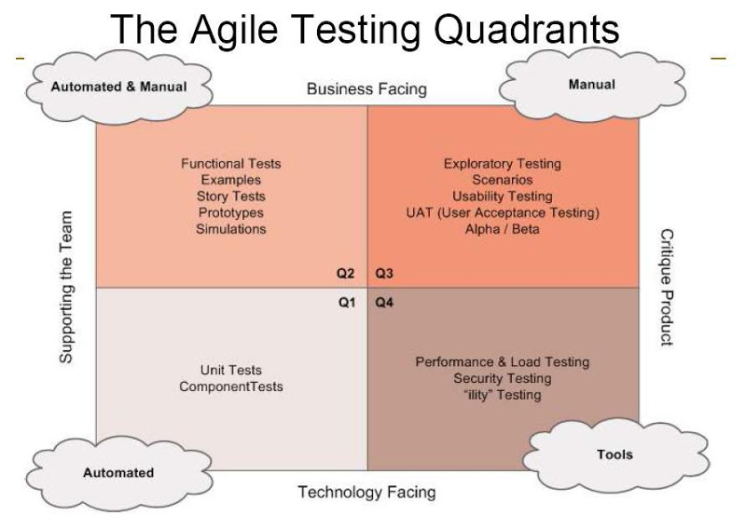
Some types of testing
Notes:
Very quickly go through what types of testing there are. Clarify that we’re talking mostly about automated testing in this conversation.

Slide 15
The Test Pyramid
UI Tests
Integration Tests
Unit Tests

Slide 16
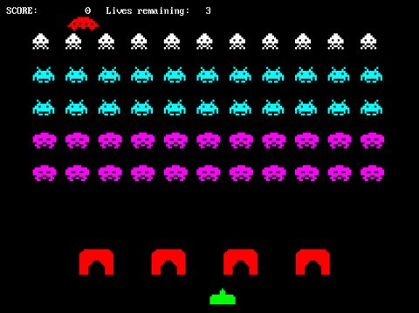
Now for the fun stuff!!!
Notes:
(SAM WILL TAKE ALL THE SPACE INVADER SLIDES, SINCE IT’S EASIER FOR HIM TO BULLSHIT ABOUT IT)
Quoth the 'pedia
"Space Invaders is a two-dimensional fixed shooter game in which the player controls a laser cannon by moving it horizontally across the bottom of the screen and firing at descending aliens."
(before going spin up 10 or so free dynos for playgrounds)
EXAMPLE TEST INVADERS
* Play for a moment to show the implementation of the laser not killing an alien.
* Explain jasmine and the "spec" DSL.
* Go through the test phase to show how one writes a test first.
* But the ship never dies either....
* Go through writing tests for the ship.
Now have students pair (or triple up) and implement a new feature(s)

Slide 17
An Invader

Slide 18
The Swarm

Slide 19
The Tank

Slide 20
The Tank's Bullet

Slide 21
An Invader's Bullet

Slide 22
An approximation of game programming
while (true) {
update_everything(delta_time);
collide_everything();
draw_everything();
}

Slide 23
The Theatre of War
Invader {
active: [true, false]
box: { x, y, width, height }
update(time, input)
collide(what hit)
team: [Team.Earth, Team.Invader]
}
Collisions occur when
bounding boxes overlap

Slide 24
Ideas for new features
Gameover when the ship dies.
Multiple lives
Score that displays
High score chart
Multiple bullets per tank

Slide 25

Notes:
Now we play…
*queue Jeopardy music*

Slide 26
Showcase

Slide 27
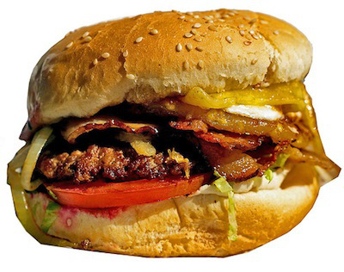
Takeaways
Testing is what professionals do.
Testing first is even better
Testing first changes how you think about coding
Testing is not more work
Notes:
(MAC YOU DRIVE THE TAKEAWAYS AND THE RETRO)
Also… testing is delicious?
NOMNOMNOMNOMNOMNOM
NOMNOMNOM
NOMNOMNOM
NOMNOMNOM
NOMNOMNOM
NOMNOMNOMNOMNOMNOM
NOMNOMNOMNOMNOMNOM
NOMNOMNOMNOMNOMNOMNOMNOMNOMNOMNOMNOMNOMNOMNOM

